Slide 1
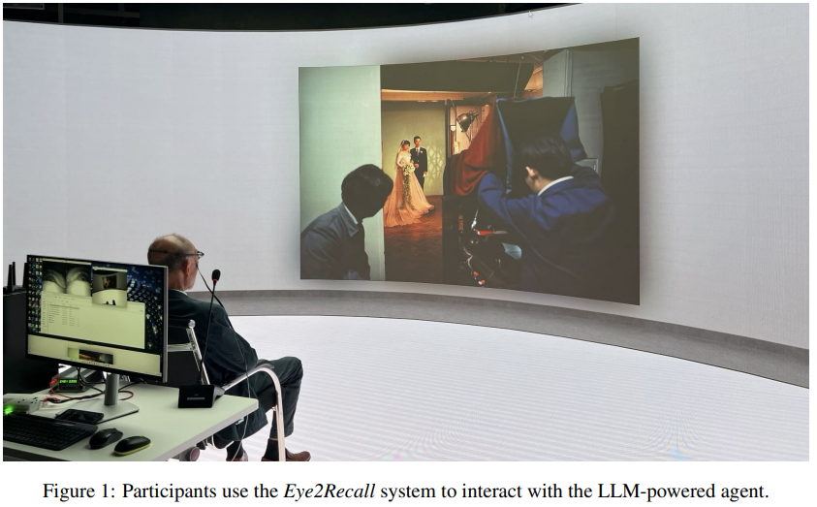
PAPER REVIEW PRESENTATION
Course: HCI – MS Program, UIU

Slide 2
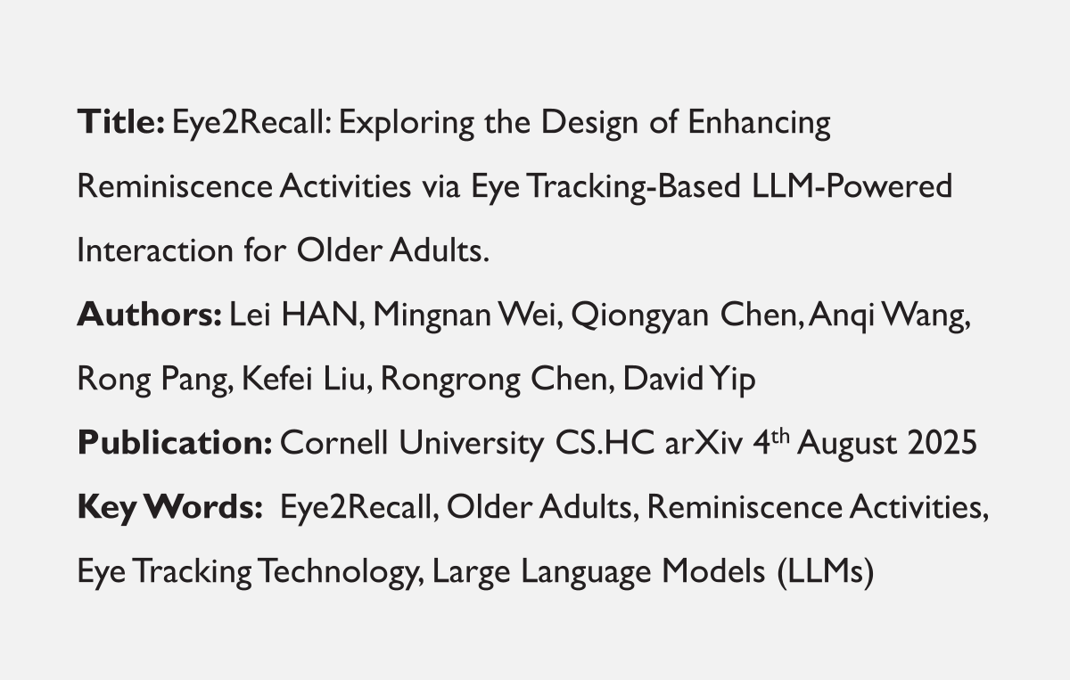
Presented To
Dr. Jannatun Noor Mukta
Associate Professor, Dept. Of CSE
Presented By
Md. Ahsan Kabir (0122520016)

Slide 3
Presented To
Dr. Jannatun Noor Mukta
Associate Professor, Dept. Of CSE
Presented By
Md. Ahsan Kabir (0122520016)

Slide 4
PROBLEM DEFINITION (1/2)
Reminiscence is critical for older adults’ well-being and memory recall.
Traditional photo-based reminiscence tools exist.
BUT: Most rely on text-based interaction (not natural for seniors).
Lack personalization and sensitivity to users’ needs.
Limited research on gaze + speech + LLM integration.

Slide 5
PROBLEM DEFINITION (2/2)
Research Questions (RQ):
How can the integration of LLM with eye-tracking technology enhance the conversational experience among older adults during reminiscence activities?
How can LLM-powered conversation with eyetracking augmentation benefit older adults through reminiscence activities experience?

Slide 6
MOTIVATION (1/2)
Aging population faces memory decline & social isolation.
Reminiscence therapy proven to boost self-expression, mood, and identity.
Aids dementia care and mental health.
Challenge: Older adults often struggle with complex UIs and voice/text-only systems.

Slide 7
MOTIVATION (2/2)
Eye-tracking provides natural, low-effort interaction.
Potential to:
Capture visual interest automatically.
Reduce cognitive load.
Encourage richer, more personalized conversations.

Slide 8
MAIN CONTRIBUTION (1/3)
We conducted expert interview studies to understand the design considerations in older adults’ reminiscence activities, potential challenges, and opportunities for LLMs to improve the design of photo-based reminiscence tools.

Slide 9
MAIN CONTRIBUTION (2/3)
We have developed a prototype system Eye2Recall to help older adults interact with an LLM-powered agent while looking at old photos. The system provides personalised reminiscence conversations by asking specific questions based on visual cues captured from the older adult.

Slide 10
MAIN CONTRIBUTION (3/3)
We conducted a user study with 10 older adults to evaluate the usability and effectiveness of Eye2Recall, and we also provide insights based on our findings to inform the design and development of future related work.

Slide 11
SOLUTION APPROACH (1/5)
System: Eye2Recall
Combines:
Eye-tracking → detects what user looks at in a photo.
LLM-powered dialogue → generates personalized conversation prompts.
Voice interaction → natural Q&A flow.

Slide 12
SOLUTION APPROACH (2/5)
Design Process:
Expert Interviews (4 experts): Key considerations → simplicity, accessibility, cultural relevance, chronological order.
Design Guidelines:
Low cognitive load.
Supportive dialogue tone.
Accessibility (large fonts, loud audio, safe environment).
Use generic cultural photos as memory triggers.

Slide 13
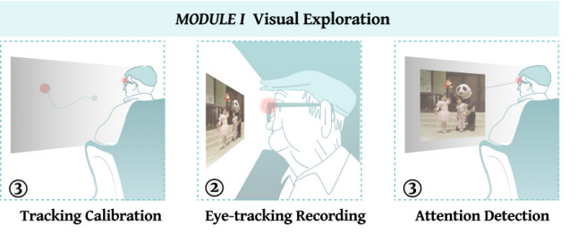
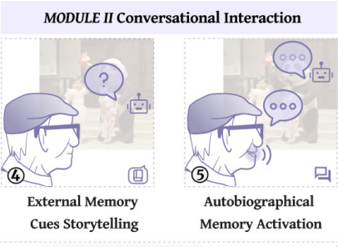
SOLUTION APPROACH (3/5)
System Architecture:
Visual Exploration Module
Eye-tracking calibration.
Attention detection → heatmaps.
Conversational Interaction Module
Summarize photo.
Generate questions linked to user’s gaze + cultural context.
Voice-based conversation.

Slide 14
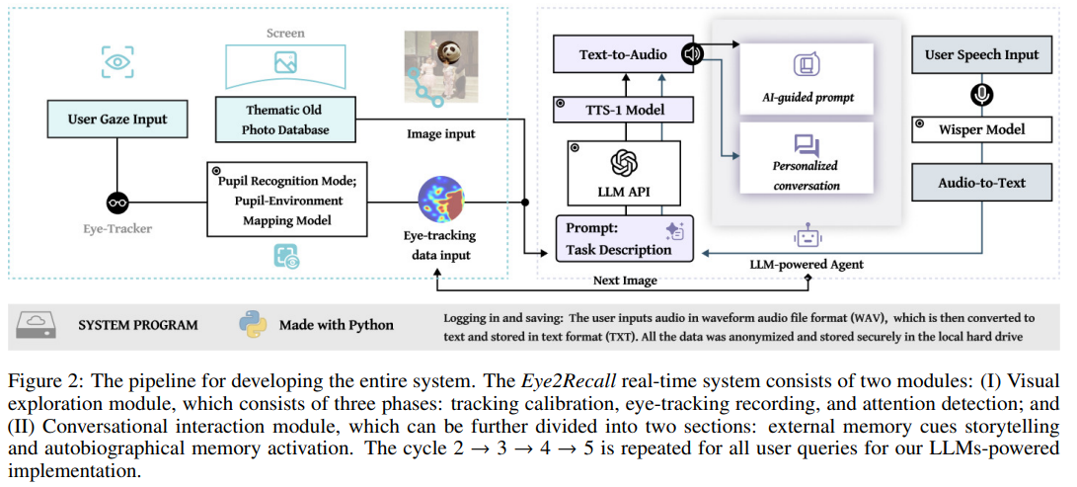
SOLUTION APPROACH (4/5)

Slide 15
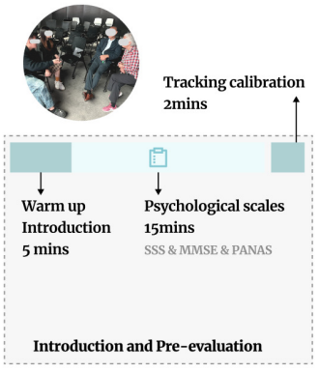
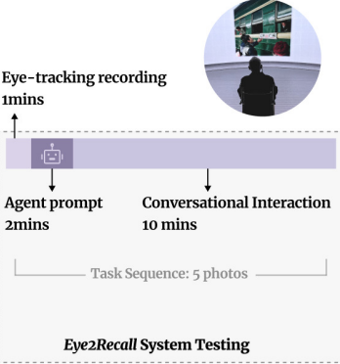
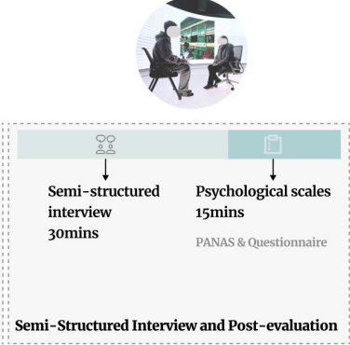
SOLUTION APPROACH (5/5)
User Study (10 older adults, 60–84 yrs):
Pre-test: baseline mood + cognition.
System testing: explore old photos + AI chat.
Post-test: usability surveys + interviews.
Findings:
Easy & natural interaction.
Improved mood (↑14% positive affect, ↓15% negative affect).
Personalized conversations tied to gaze.

Slide 16
SUBSEQUENT ADVANCEMENTS
Similar research in AI reminiscence systems:
GoodTimes – AI photo album (Wang et al.).
Voice-based chatbots for dementia care.
Eye2Recall extends this by fusing gaze data with LLMs.
Future opportunities:
Emotional sentiment detection.
Digital legacy preservation (family memory archives).
Larger, diverse participant groups.

Slide 17
STRENGTHS
✅ Natural, low-effort interaction (eye + voice).
✅ Personalized & engaging reminiscence.
✅ Improved emotional well-being.
✅ Provides design guidelines for aging-centered HCI.

Slide 18
WEAKNESSES
⚠ Small sample size (10, all Chinese seniors).
⚠ Limited longitudinal evaluation.
⚠ Technical limitations (OCR errors, AI pauses).
⚠ Some privacy/ethical concerns.

Slide 19
DISCUSSION POINTS
Should reminiscence systems capture & store a digital legacy for families?
How to balance personalization vs. privacy?
Can this be extended for cross-cultural older adults?
Ethical concerns if AI-generated prompts trigger negative emotions.

Slide 20
CONCLUSION
Eye2Recall = first system merging eye-tracking + LLMs for reminiscence.
Contributions:
Novel system design.
Expert-informed guidelines.
User study validating positive impact.
Takeaway: Enhancing older adults’ well-being via natural, intuitive, AI-powered reminiscence.

Slide 21
THANK YOU
References
https://arxiv.org/abs/2508.02232v1
https://arxiv.org/pdf/2508.02232
Any Questions?

